Slide 1


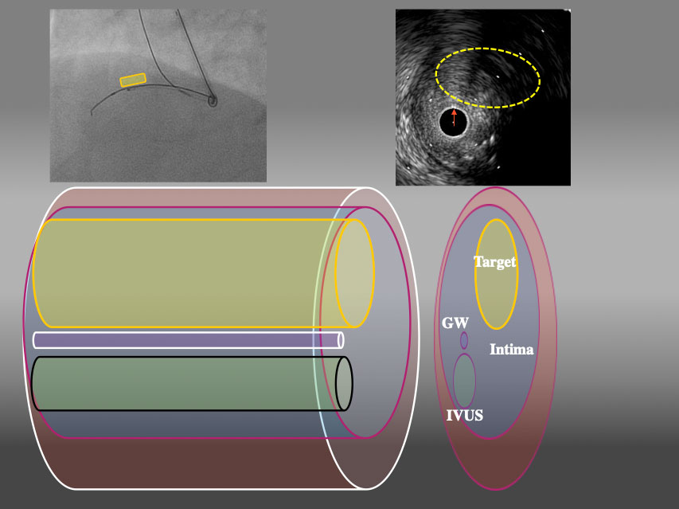

The role of imaging in coronary chronic total occlusion intervention
Figure 9c
3D schema of IVUS finding from LAO45° From LAO view, Target intimal plaque was located upper side of IVUS catheter (yellow area).
Masahisa Yamane, Kenya Nasu, Masaaki Okutsu, Makoto Sekiguchi
©2025 Europa Group - All rights reserved.

