Slide 1


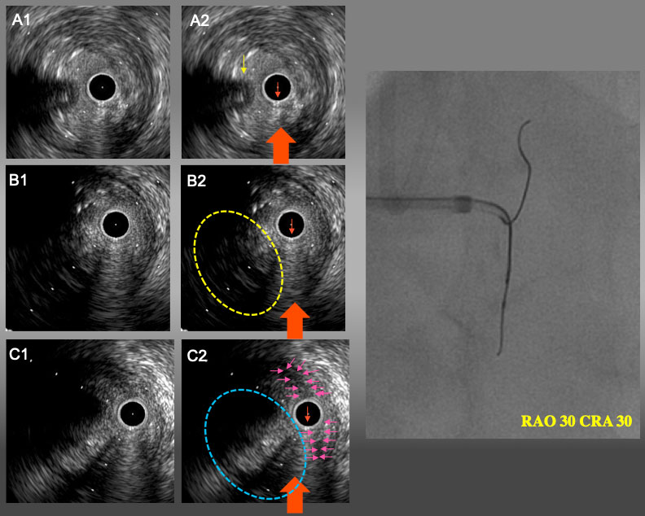

The role of imaging in coronary chronic total occlusion intervention
Figure 9d
IVUS finding and angiogram from RAO30°CRA30° A1 and A2: Proximal bifurcation. Guide wire in conus branch (yellow arrow) came from 9 o’clock (left side of IVUS catheter). B1 and B2: the point of deviation. Target intimal plaque was seen at 8 o’clock. C1 and C2: IVUS catheter was located in sub-intimal space with a small semi-lunar hematoma (pink arrows). Target intimal plaque was seen at 8 o’clock (blue dot line circle). In RAO30°CRA30°view, IVUS guide wire and IVUS catheter were overlapped and side branch guide wire were seen left side of IVUVS catheter. Therefore, the red arrow is RAO CRA projection in IVUS image(A2,B2, and C2).
Masahisa Yamane, Kenya Nasu, Masaaki Okutsu, Makoto Sekiguchi
©2025 Europa Group - All rights reserved.

