Slide 1


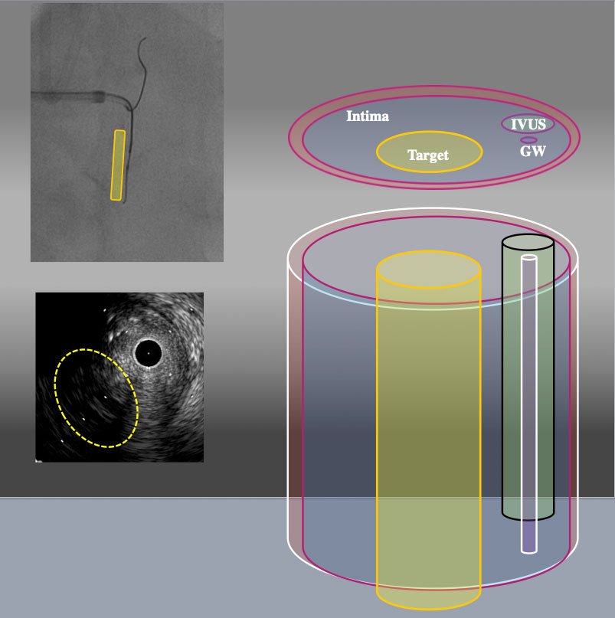

The role of imaging in coronary chronic total occlusion intervention
Figure 9e
3D schema of IVUS findings from RAO30° CRA30° From RAO CRA view, Target intimal plaque was located left side of IVUS catheter (yellow area).
Masahisa Yamane, Kenya Nasu, Masaaki Okutsu, Makoto Sekiguchi
©2025 Europa Group - All rights reserved.

