Slide 1


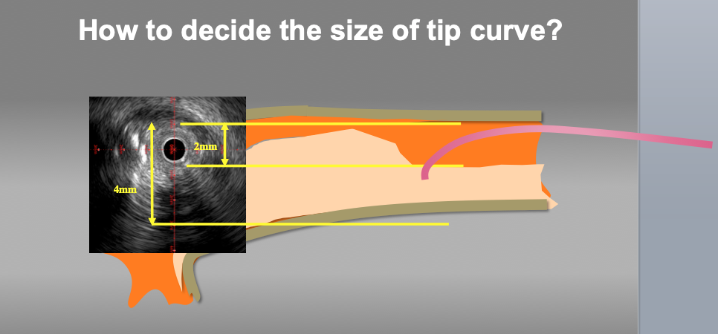
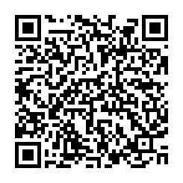
The role of imaging in coronary chronic total occlusion intervention
Figure 9f
Measure to decide the size of the wire tip curve. Appropriate wire tip curve can be estimated according to the lumen and vessel size at the point of deviation. In this case, the size of tip curve from 3 to 3.5mm should be approapriate for re-wiring.
Masahisa Yamane, Kenya Nasu, Masaaki Okutsu, Makoto Sekiguchi
©2025 Europa Group - All rights reserved.

