Slide 1


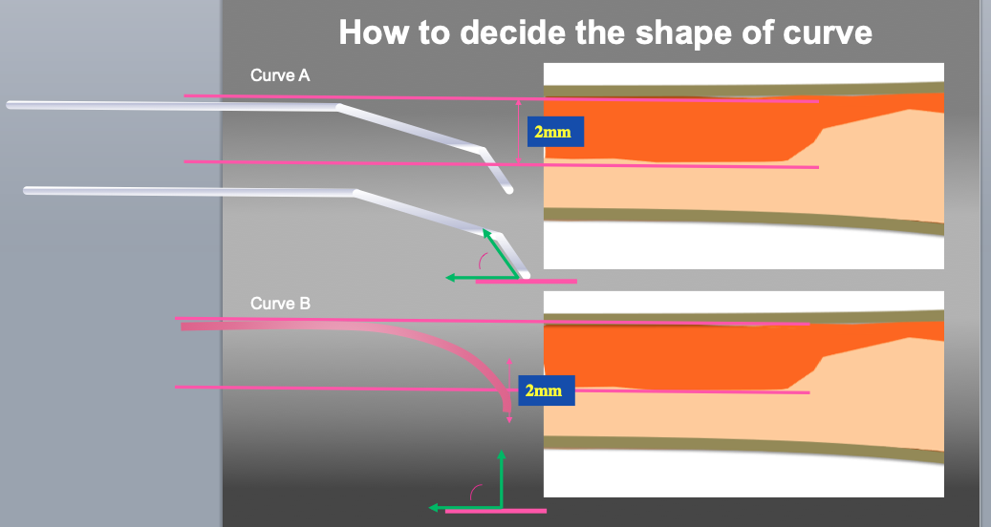

The role of imaging in coronary chronic total occlusion intervention
Figure 9g
Measure to decide the shape of the wire tip curve. Even the same size of tip curve, the shape is a key factor of penetration efficiency. Curve A (small 1st curve with second curve) is recommended as 1st step. If re-wiring (penetration of target plaque) is difficult with curve A, then Curve B (large one curve) can be recommended.
Masahisa Yamane, Kenya Nasu, Masaaki Okutsu, Makoto Sekiguchi
©2025 Europa Group - All rights reserved.

