Slide 1


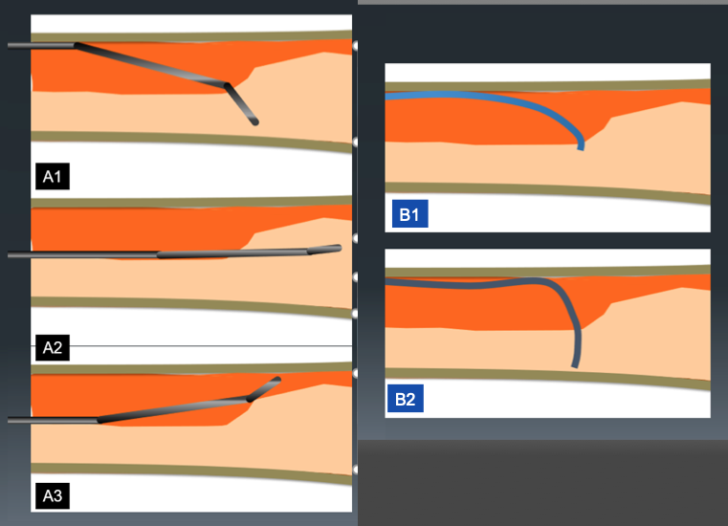

The role of imaging in coronary chronic total occlusion intervention
Figure 9h
Difference of guide wire motion between curve A and B. Because of narrow angle between guide wire tip and intimal plaque, direction control of tip curve A is better than tip with curve B (A1-2, B1-2). However, the incidence of slip ( when the wire does not penetrate deep enough ) at the point of deviation is higher (A3).
Masahisa Yamane, Kenya Nasu, Masaaki Okutsu, Makoto Sekiguchi
©2025 Europa Group - All rights reserved.

