Slide 1


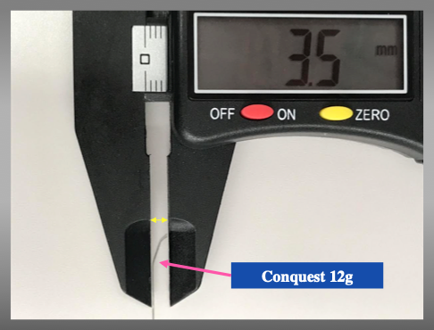

The role of imaging in coronary chronic total occlusion intervention
Figure 9i
Representative curve shape and size of Conquest 12g.
Masahisa Yamane, Kenya Nasu, Masaaki Okutsu, Makoto Sekiguchi
©2025 Europa Group - All rights reserved.

