Slide 1


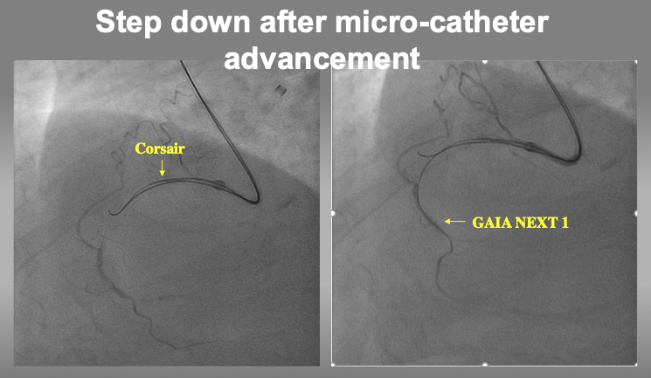

The role of imaging in coronary chronic total occlusion intervention
Figure 9k
After confirmation of 2nd wire position in IVUS, micro-catheter can advance into the target intimal plaque for stepping down to a torquable guide wire (such as GAIA1, Miracle Neo 3, UB3, or XT-R).
Masahisa Yamane, Kenya Nasu, Masaaki Okutsu, Makoto Sekiguchi
©2025 Europa Group - All rights reserved.

