Slide 1


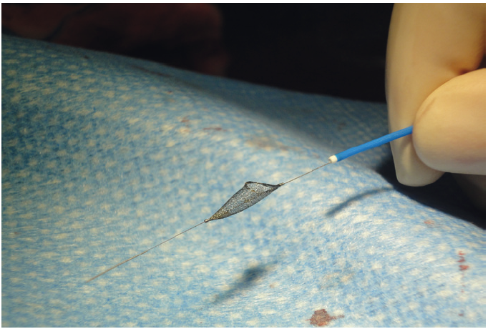

Thrombectomy and target vessel protection during PCI
Figure 13
SpiderFX® embolic protection device (eV3) – deployed configuration.
Angelo Quagliana, Simone Biscaglia, Anna Giulia Pavon, Marco Valgimigli
©2025 Europa Group - All rights reserved.

