Slide 1


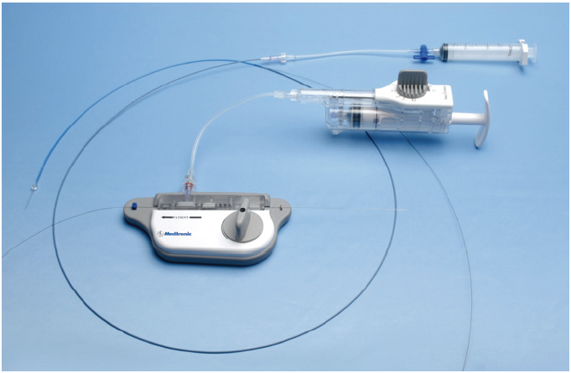

Thrombectomy and target vessel protection during PCI
Figure 17
PercuSurge GuardWire (Medtronic) catheter system.
Angelo Quagliana, Simone Biscaglia, Anna Giulia Pavon, Marco Valgimigli
©2025 Europa Group - All rights reserved.

