Slide 1


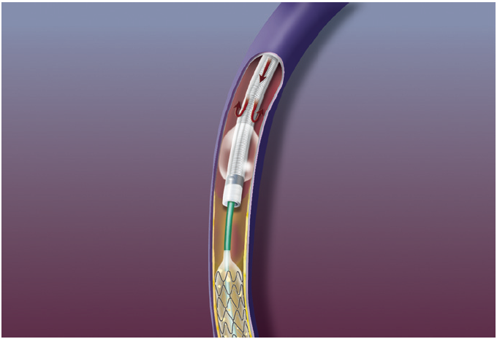

Thrombectomy and target vessel protection during PCI
Figure 20
Proxis system deployed stopping antegrade blood flow during protected PCI (St. Jude Medical).
Angelo Quagliana, Simone Biscaglia, Anna Giulia Pavon, Marco Valgimigli
©2025 Europa Group - All rights reserved.

