Slide 1


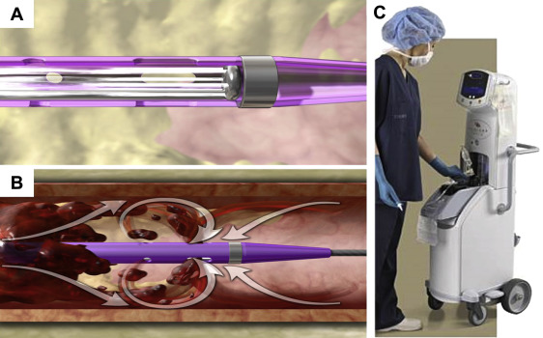

Thrombectomy and target vessel protection during PCI
Figure 9
Retrograde saline high-velocity flow in Angiojet system´s tip (A) to achieve vacuum and aspiration thrombectomy according to Bernoulli´s principle (B). AngioJet system console (C).
Angelo Quagliana, Simone Biscaglia, Anna Giulia Pavon, Marco Valgimigli
©2025 Europa Group - All rights reserved.

