Slide 1


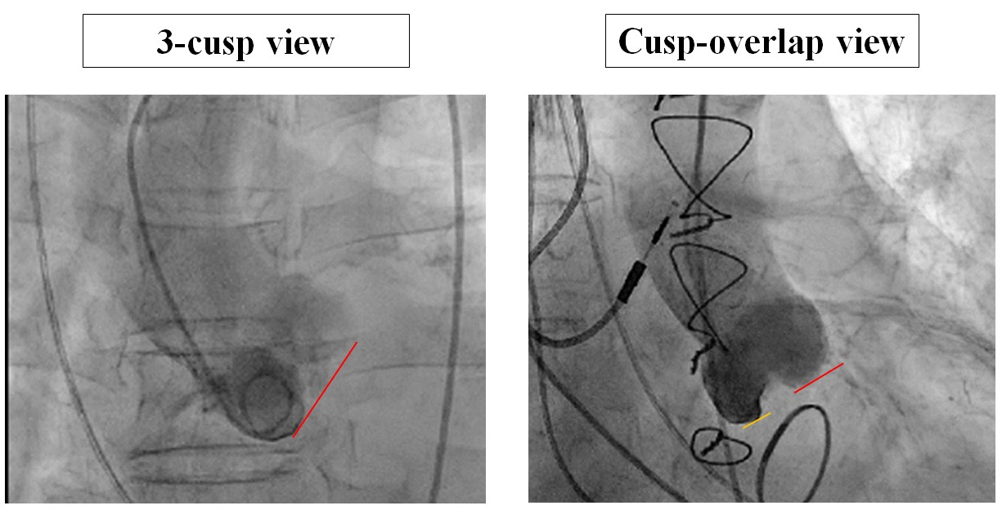

Transcatheter aortic valve implantation (old)
Figure 15
Cusp-overlap view and annulus plane view
Taishi Okuno, Daijiro Tomii, Thomas Pilgrim, Stephan Windecker
©2025 Europa Group - All rights reserved.

