Slide 1


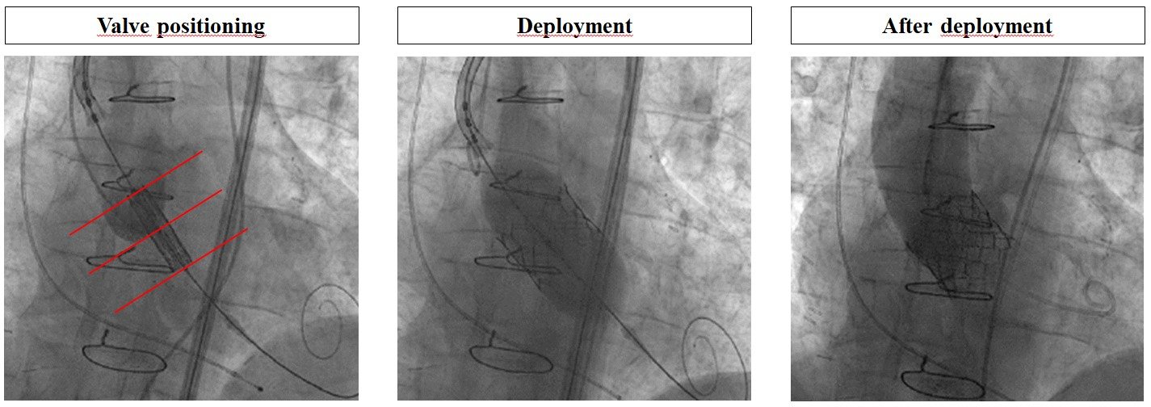

Transcatheter aortic valve implantation (old)
Figure 16
Transcatheter heart valve deployment: SAPIEN 3
Taishi Okuno, Daijiro Tomii, Thomas Pilgrim, Stephan Windecker
©2025 Europa Group - All rights reserved.

