Slide 1


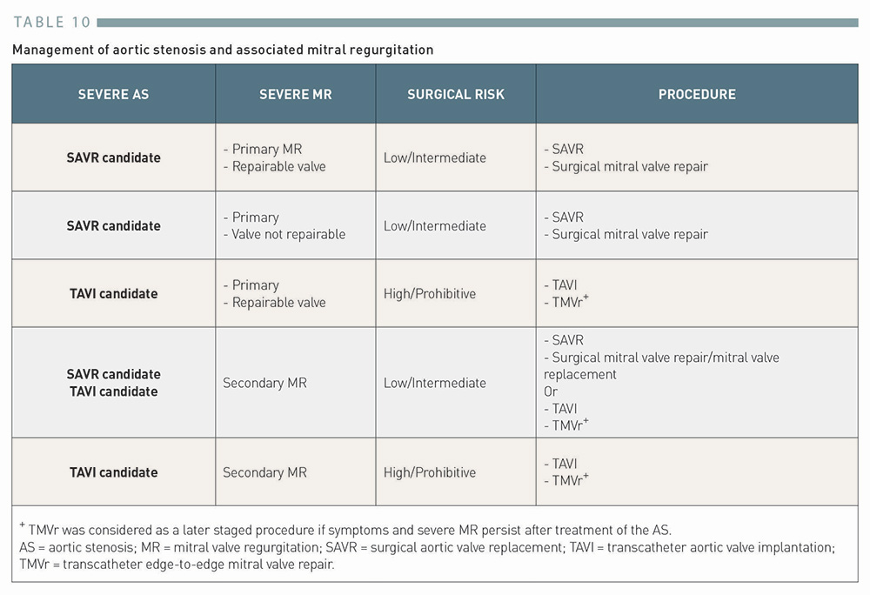

Transcatheter aortic valve implantation (old)
Table 10
Management of aortic stenosis and associated mitral regurgitation
Taishi Okuno, Daijiro Tomii, Thomas Pilgrim, Stephan Windecker
©2025 Europa Group - All rights reserved.

