Slide 1


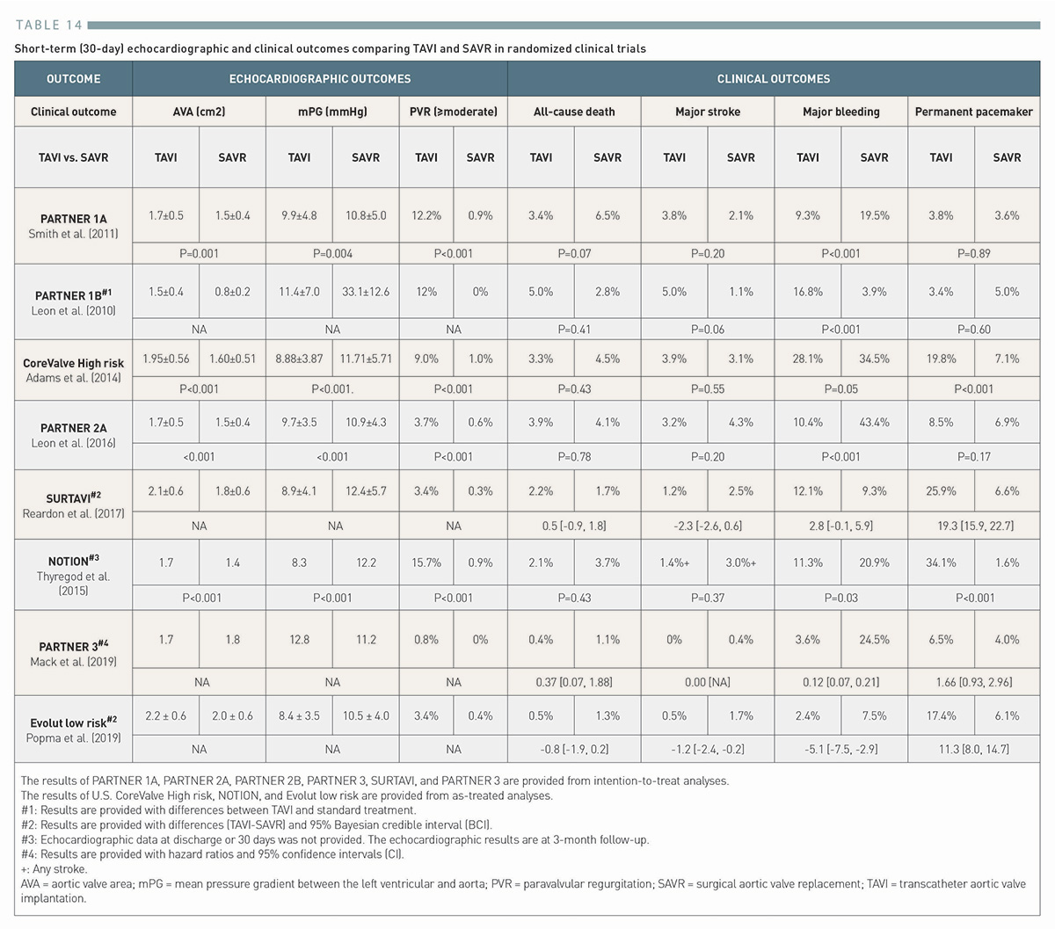

Transcatheter aortic valve implantation (old)
Table 14
Short-term (30-day) echocardiographic and clinical outcomes comparing TAVI and SAVR in randomized clinical trials
Taishi Okuno, Daijiro Tomii, Thomas Pilgrim, Stephan Windecker
©2025 Europa Group - All rights reserved.

