Slide 1


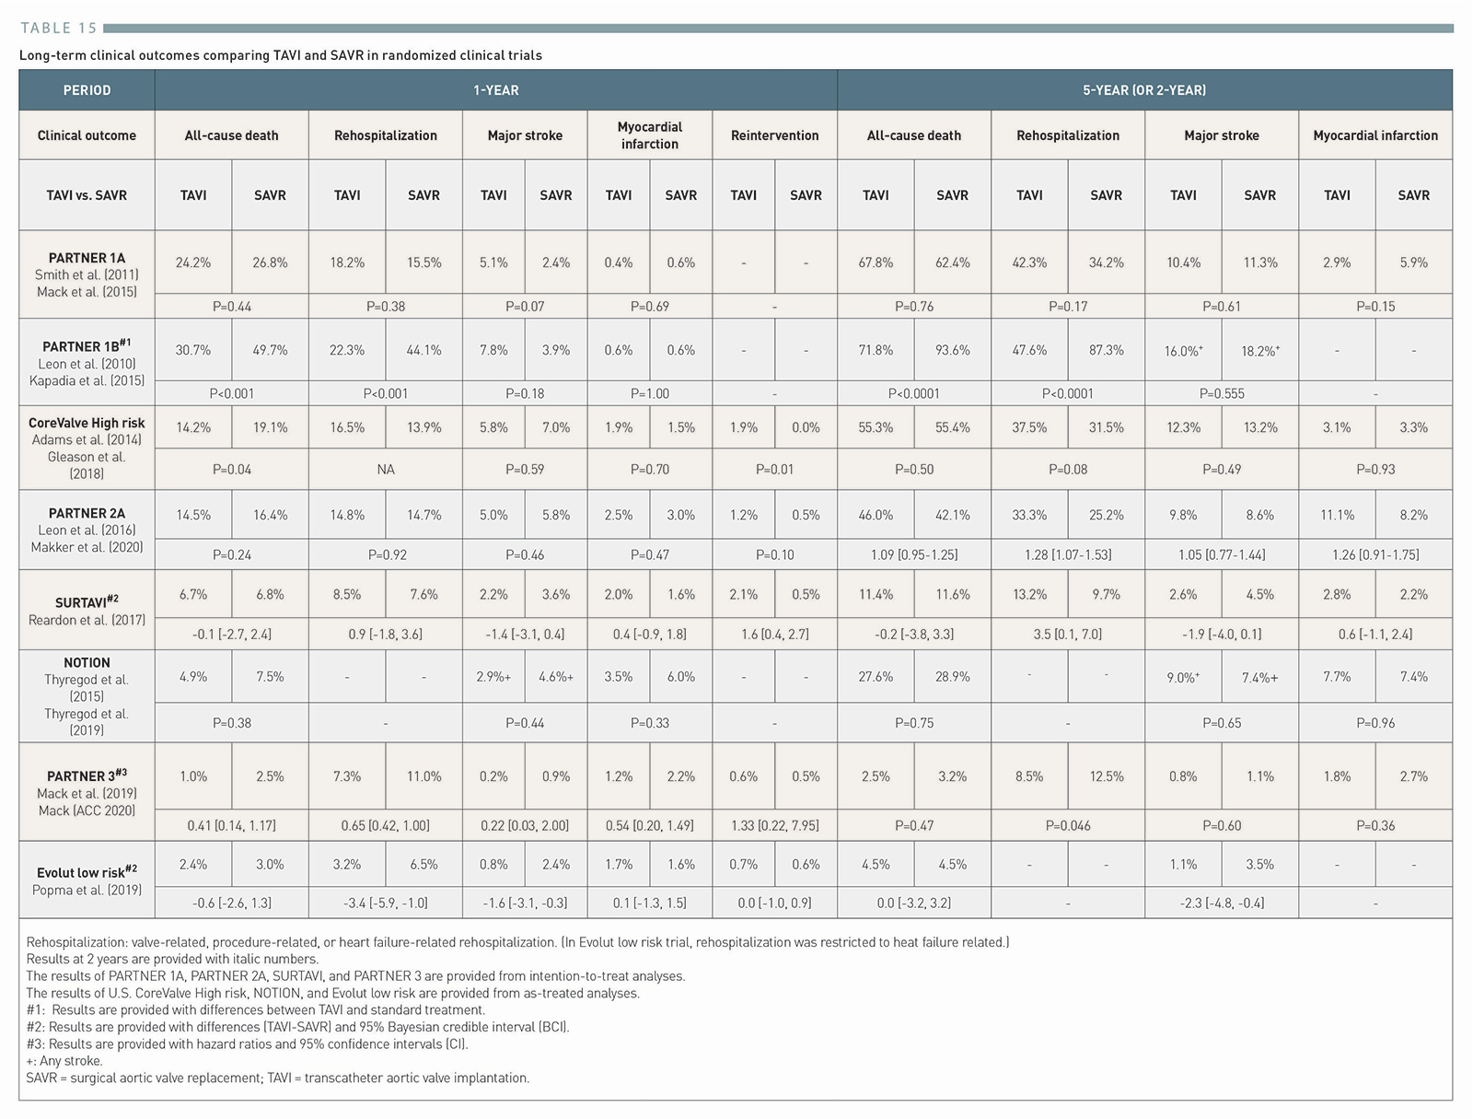

Transcatheter aortic valve implantation (old)
Table 15
Long-term clinical outcomes comparing TAVI and SAVR in randomized clinical trials.
Taishi Okuno, Daijiro Tomii, Thomas Pilgrim, Stephan Windecker
©2025 Europa Group - All rights reserved.

