Slide 1


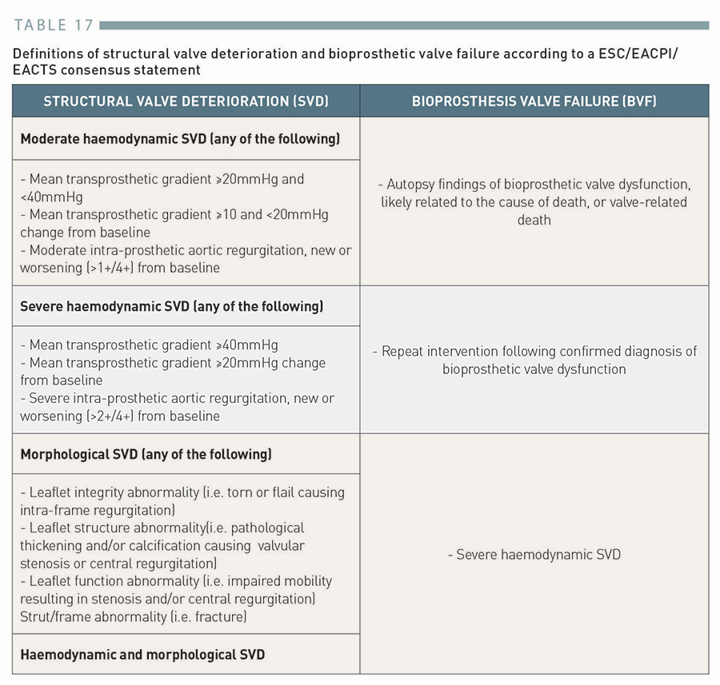

Transcatheter aortic valve implantation (old)
Table 17
Definitions of structural valve deterioration and bioprosthetic valve failure according to a ESC/EACPI/EACTS consensus statement
Taishi Okuno, Daijiro Tomii, Thomas Pilgrim, Stephan Windecker
©2025 Europa Group - All rights reserved.

