Slide 1


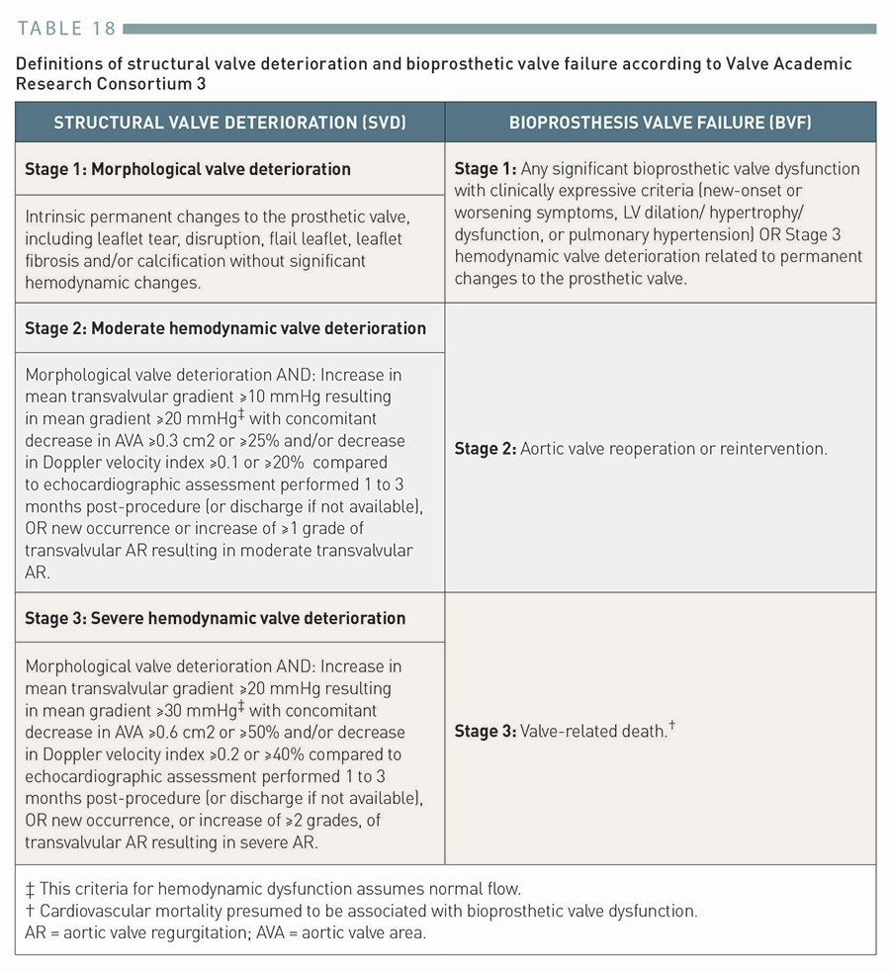

Transcatheter aortic valve implantation (old)
Table 18
Definitions of structural valve deterioration and bioprosthetic valve failure according to Valve Academic Research Consortium 3
Taishi Okuno, Daijiro Tomii, Thomas Pilgrim, Stephan Windecker
©2025 Europa Group - All rights reserved.

