Slide 1


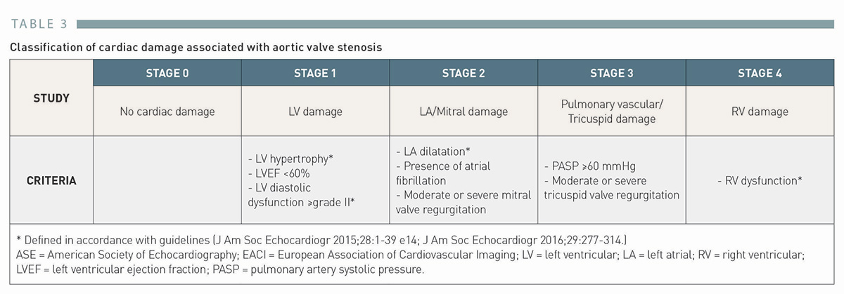

Transcatheter aortic valve implantation (old)
Table 3
Classification of cardiac damage associated with aortic valve stenosis
Taishi Okuno, Daijiro Tomii, Thomas Pilgrim, Stephan Windecker
©2025 Europa Group - All rights reserved.

