Slide 1


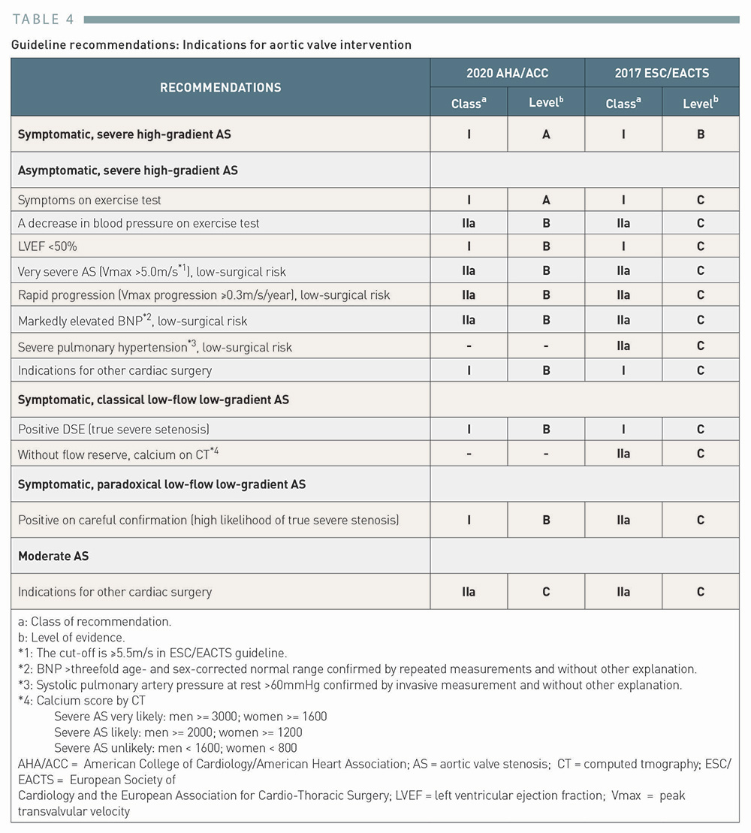

Transcatheter aortic valve implantation (old)
Table 4
Guideline recommendations: Indications for aortic valve intervention
Taishi Okuno, Daijiro Tomii, Thomas Pilgrim, Stephan Windecker
©2025 Europa Group - All rights reserved.

