Slide 1


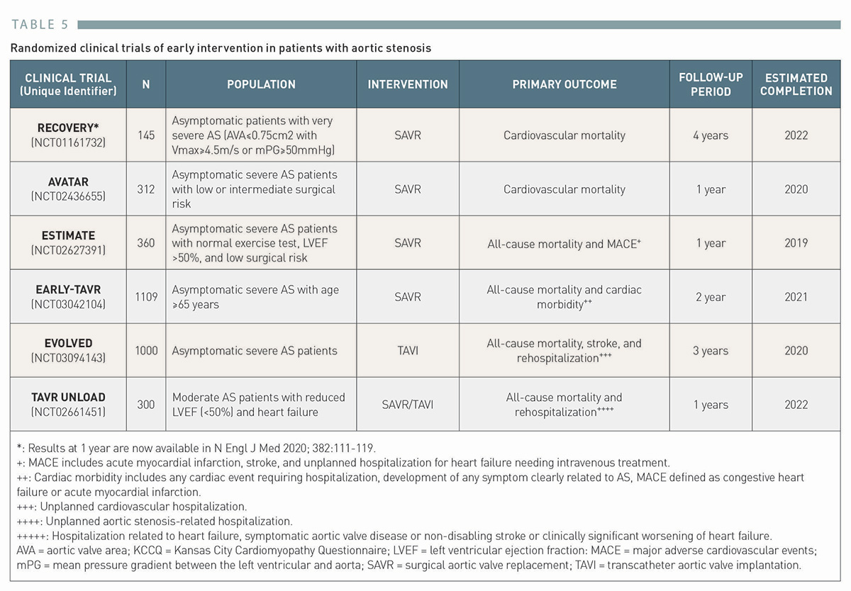

Transcatheter aortic valve implantation (old)
Table 5
Randomized clinical trials of early intervention in patients with aortic stenosis
Taishi Okuno, Daijiro Tomii, Thomas Pilgrim, Stephan Windecker
©2025 Europa Group - All rights reserved.

