Slide 1


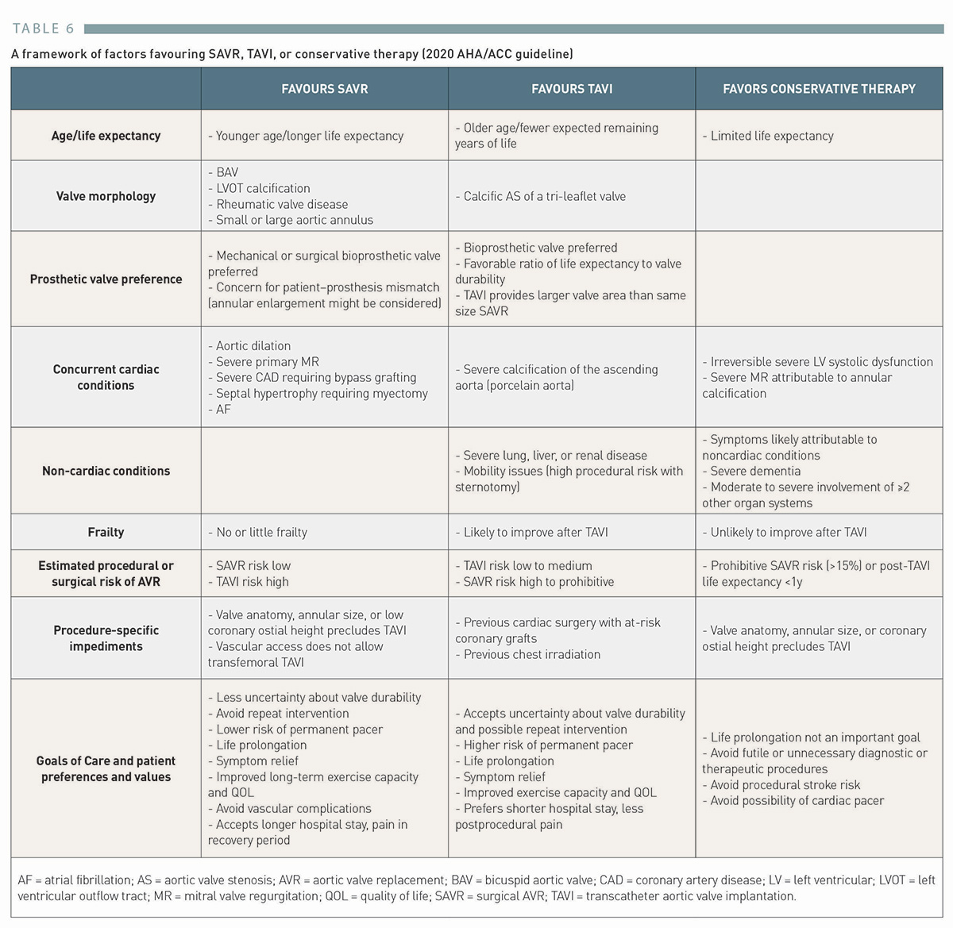

Transcatheter aortic valve implantation (old)
Table 6
A framework of factors favouring SAVR, TAVI, or conservative therapy (2020 AHA/ACC guideline)
Taishi Okuno, Daijiro Tomii, Thomas Pilgrim, Stephan Windecker
©2025 Europa Group - All rights reserved.

