Slide 1


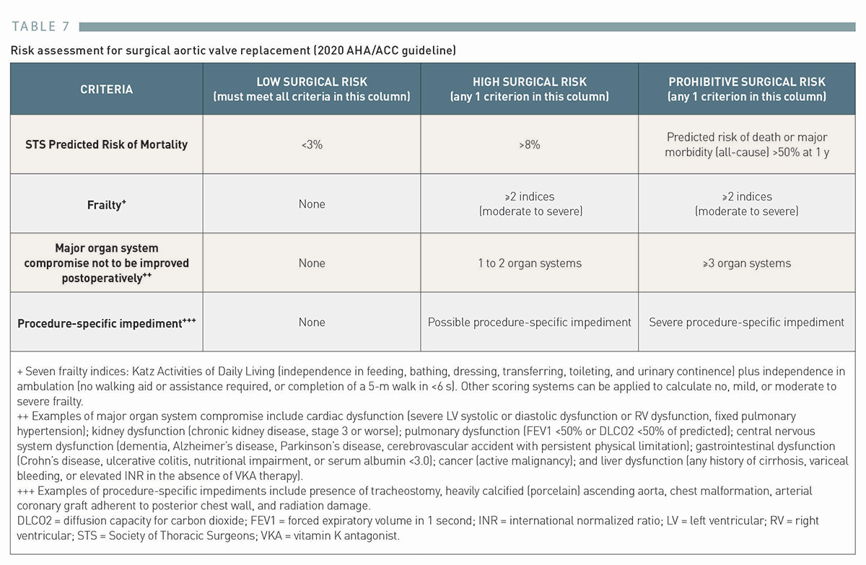

Transcatheter aortic valve implantation (old)
Table 7
Risk assessment for surgical aortic valve replacement (2020 AHA/ACC guideline)
Taishi Okuno, Daijiro Tomii, Thomas Pilgrim, Stephan Windecker
©2025 Europa Group - All rights reserved.

