Slide 1


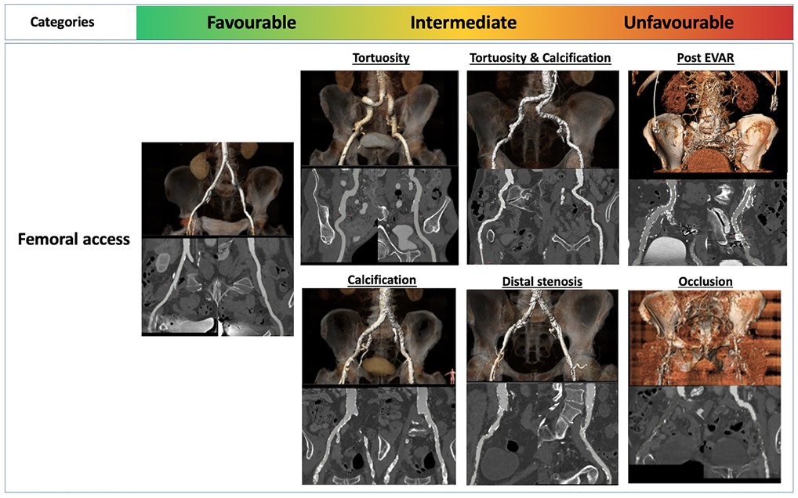

Transcatheter aortic valve implantation
Figure 12
Unfavorable iliofemoral arterial anatomy for transcatheter aortic valve implantation. Figures reproduced from Windecker et al. Eur Heart J 2022;43(29):2729-2750.
Daijiro Tomii, Thomas Pilgrim, Jonas Lanz, Taishi Okuno, Stephan Windecker
©2025 Europa Group - All rights reserved.

