Slide 1


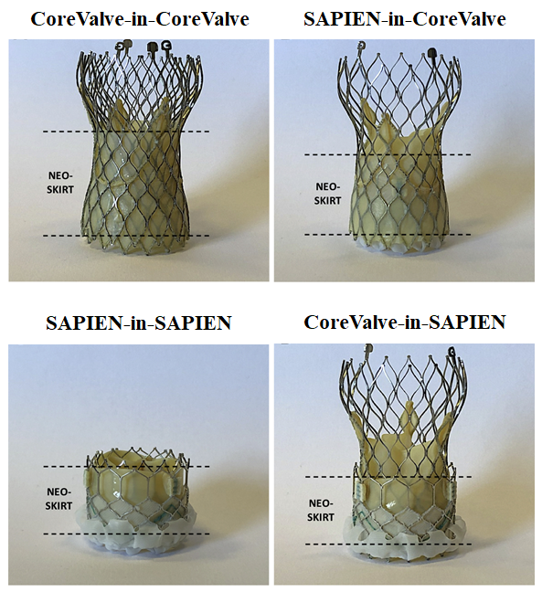

Transcatheter aortic valve implantation
Figure 14
Redo-transcatheter aortic valve implantation: different THV–in–THV combinations.Figures reproduced and modified from De Backer et al. JACC Cardiovasc Interv 2020;13(21):2528-2538.
Daijiro Tomii, Thomas Pilgrim, Jonas Lanz, Taishi Okuno, Stephan Windecker
©2025 Europa Group - All rights reserved.

