Slide 1


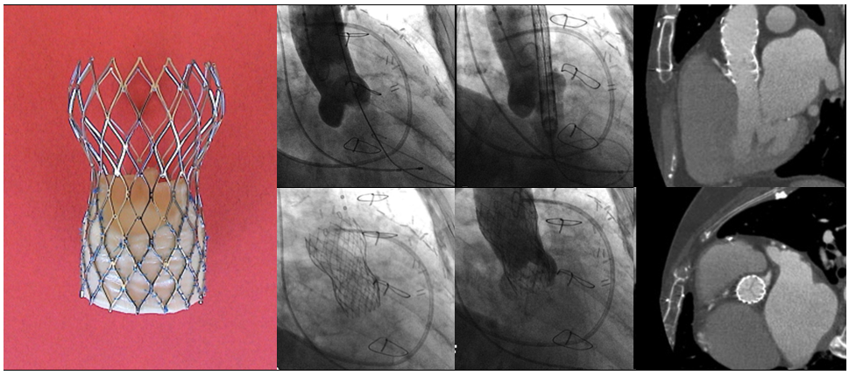

Transcatheter aortic valve implantation
Figure 2
First implantation of the self-expanding CoreValve System.Figures reproduced and modified from Grube et al. Catheter Cardiovasc Interv 2005;66(4):465-9.
Daijiro Tomii, Thomas Pilgrim, Jonas Lanz, Taishi Okuno, Stephan Windecker
©2025 Europa Group - All rights reserved.

