Slide 1


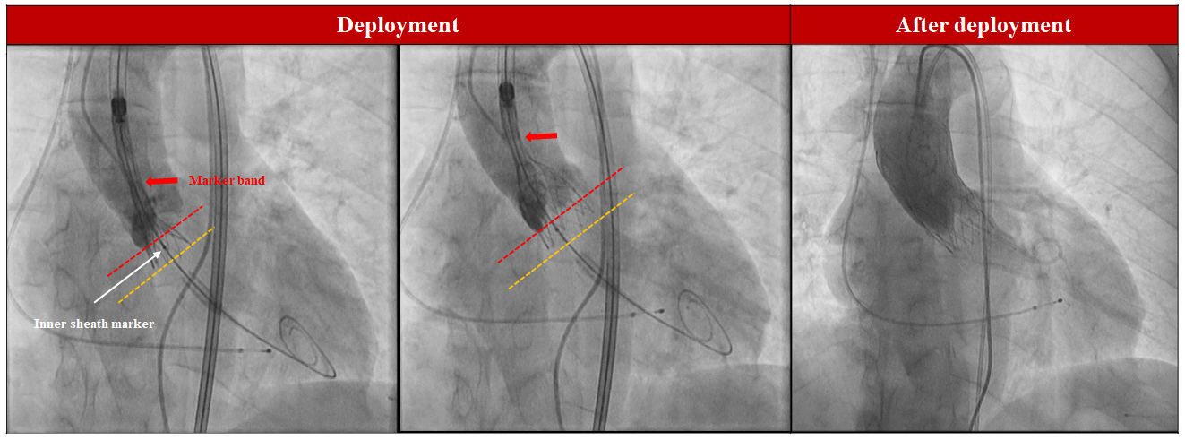

Transcatheter aortic valve implantation
Figure 22
Transcatheter heart valve deployment: Navitor system.
Daijiro Tomii, Thomas Pilgrim, Jonas Lanz, Taishi Okuno, Stephan Windecker
©2025 Europa Group - All rights reserved.

