Slide 1


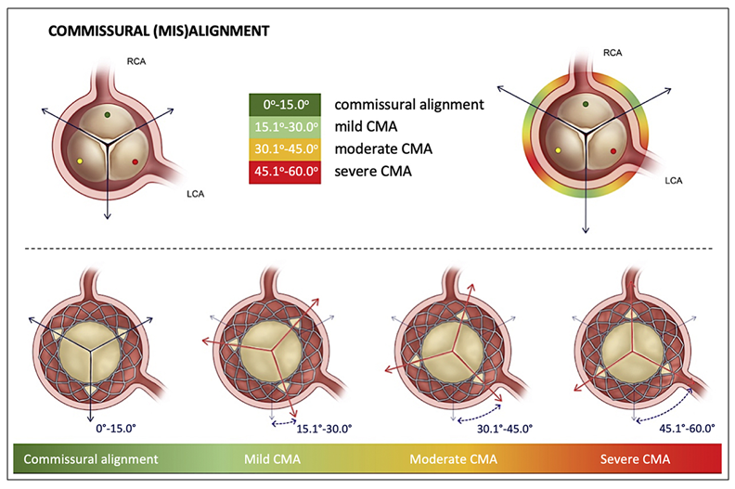

Transcatheter aortic valve implantation
Figure 24
Proposed standardized definition of commisural alignment from the ALIGN-TAVR consortium. Figures reproduced from Tang et al. JACC Cardiovasc Interv 2022;15(15):1497-1518.
Daijiro Tomii, Thomas Pilgrim, Jonas Lanz, Taishi Okuno, Stephan Windecker
©2025 Europa Group - All rights reserved.

