Slide 1


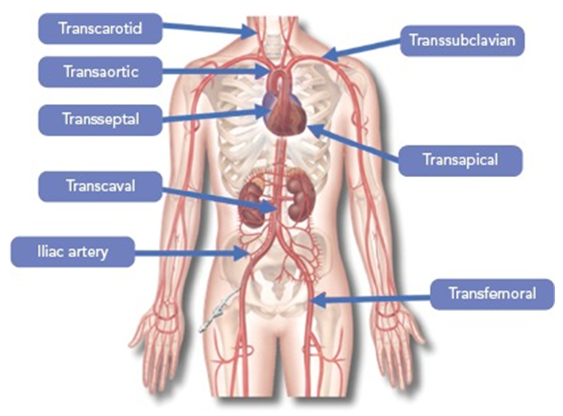

Transcatheter aortic valve implantation
Figure 25
Access sites for transcatheter aortic valve implantation. Figures reproduced from Overtchouk and Modine. Interv Cardiol 2018;13:145-150.
Daijiro Tomii, Thomas Pilgrim, Jonas Lanz, Taishi Okuno, Stephan Windecker
©2025 Europa Group - All rights reserved.

