Slide 1


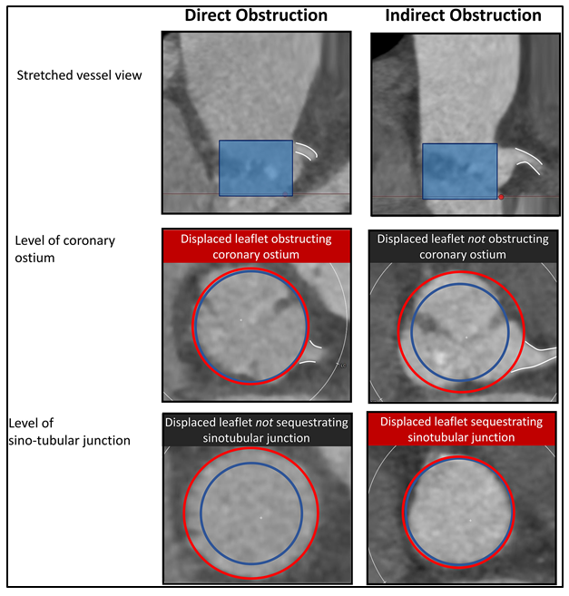

Transcatheter aortic valve implantation
Figure 27
Mechanism of coronary obstruction complicating transcatheter aortic valve implantation. Figures reproduced from Pilgrim and Tomii. JACC Cardiovasc Interv 2023;16(4)426-428.
Daijiro Tomii, Thomas Pilgrim, Jonas Lanz, Taishi Okuno, Stephan Windecker
©2025 Europa Group - All rights reserved.

