Slide 1


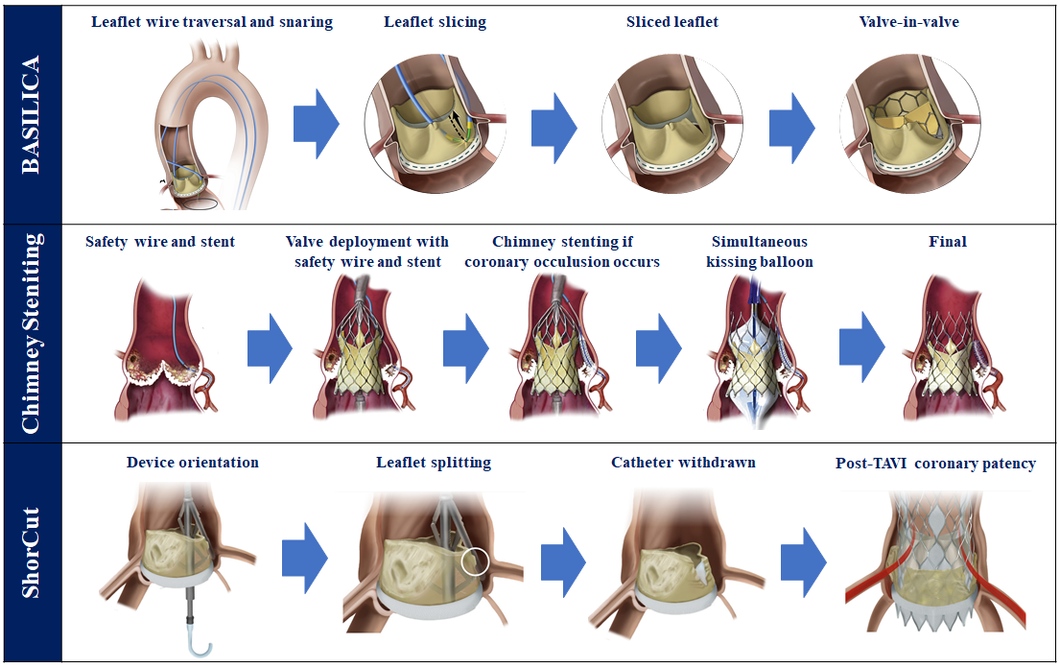

Transcatheter aortic valve implantation
Figure 28
Coronary protection techniques. Figures reproduced and modified from Khan et al. JACC Cardiovasc Interv 2018;11(7):677-689, Mercanti et al. JACC Cardiovasc Interv 2020;13(6):751-761, and Dvir et al. JACC Cardiovasc Interv 2023;16(1):94-102; and Prendergast et al. Eur Heart J 2024;45:3042-3044.
Daijiro Tomii, Thomas Pilgrim, Jonas Lanz, Taishi Okuno, Stephan Windecker
©2025 Europa Group - All rights reserved.

