Slide 1


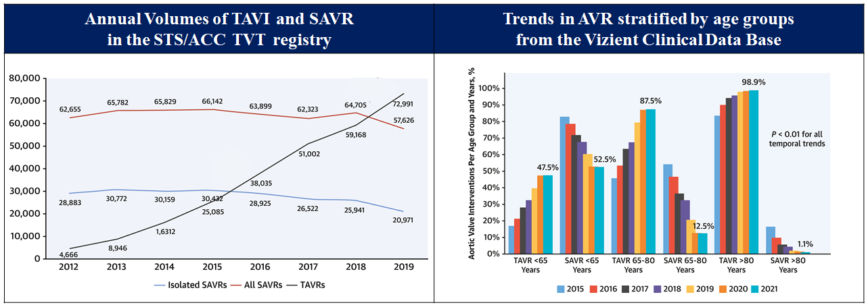

Transcatheter aortic valve implantation
Figure 3
National trend in aortic valve implantation.Figures reproduced and modified from Carroll et al. J Am Coll Cardiol 2020;76(21):2492-2516 and Sharma et al. J Am Coll Cardiol 222;80(21)2054-2056.
Daijiro Tomii, Thomas Pilgrim, Jonas Lanz, Taishi Okuno, Stephan Windecker
©2025 Europa Group - All rights reserved.

