Slide 1


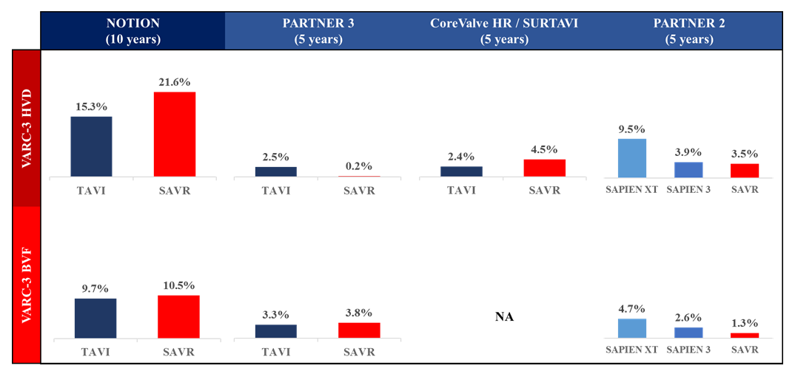

Transcatheter aortic valve implantation
Figure 30
Valve durability comparing transcatheter and surgical bioprostheses in ranodomized control trials.Data reproduced from Thyregod et al. Eur Heart J 2024;45:1116-1124; Mack et al. N Nngl J Med 2023;389:1949-1960; Yakubo et al. J Am Coll Cardiol 2025. [Online ahead of print]. doi: 10.1016/j.jacc.2025.02.009; and Pibarot et al. J Am Coll Cardiol 2020;76:1830-1843.
Daijiro Tomii, Thomas Pilgrim, Jonas Lanz, Taishi Okuno, Stephan Windecker
©2025 Europa Group - All rights reserved.

