Slide 1


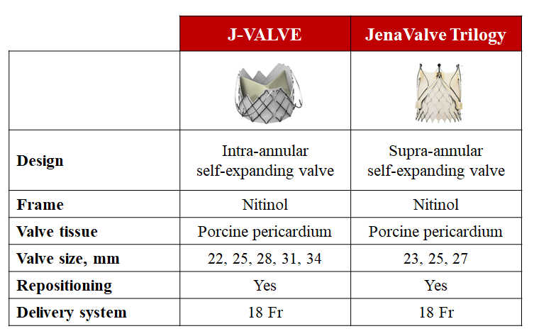

Transcatheter aortic valve implantation
Figure 33
Dedicated transcatheter aortic valve implantation devices for the treatment of pure aortic regurgitation.
Daijiro Tomii, Thomas Pilgrim, Jonas Lanz, Taishi Okuno, Stephan Windecker
©2025 Europa Group - All rights reserved.

