Slide 1


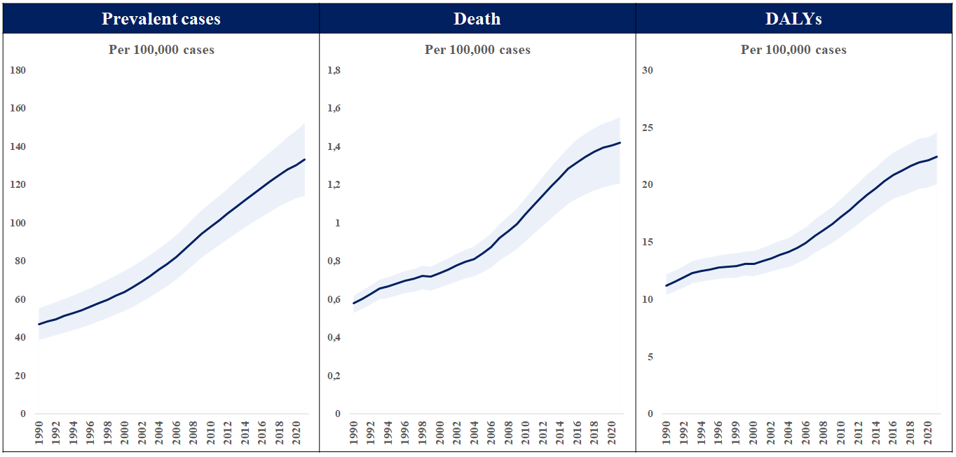

Transcatheter aortic valve implantation
Figure 5
Total number of prevalent cases, death, and disability-adjusted life years (DALYs) to non-rheumatic calcific aortic valve disease between 1990 and 2021.Data obtained from the Global Burden of Disease Study 2021.
Daijiro Tomii, Thomas Pilgrim, Jonas Lanz, Taishi Okuno, Stephan Windecker
©2025 Europa Group - All rights reserved.

