Slide 1


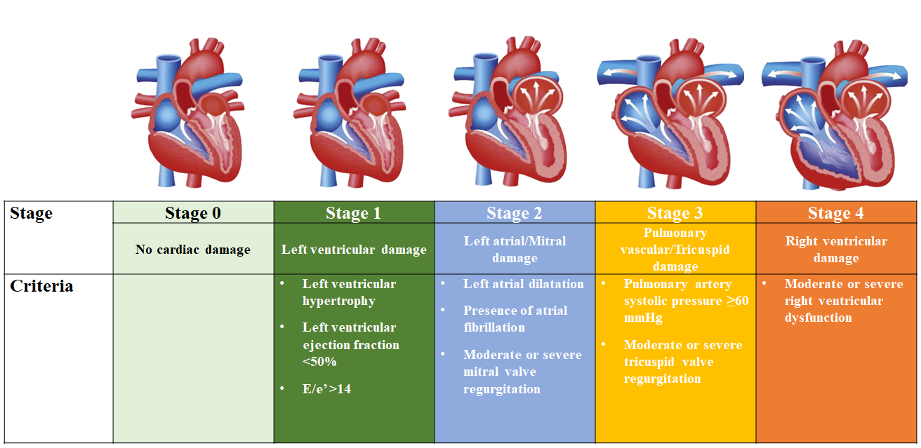

Transcatheter aortic valve implantation
Figure 6
Proposed staging classification to quantify the extent of cardiac damage among patients with aortic stenosis.Figures reproduced and modified from Généreux et al. J Am Coll Cardiol 2022;80:783-800.
Daijiro Tomii, Thomas Pilgrim, Jonas Lanz, Taishi Okuno, Stephan Windecker
©2025 Europa Group - All rights reserved.

