Slide 1


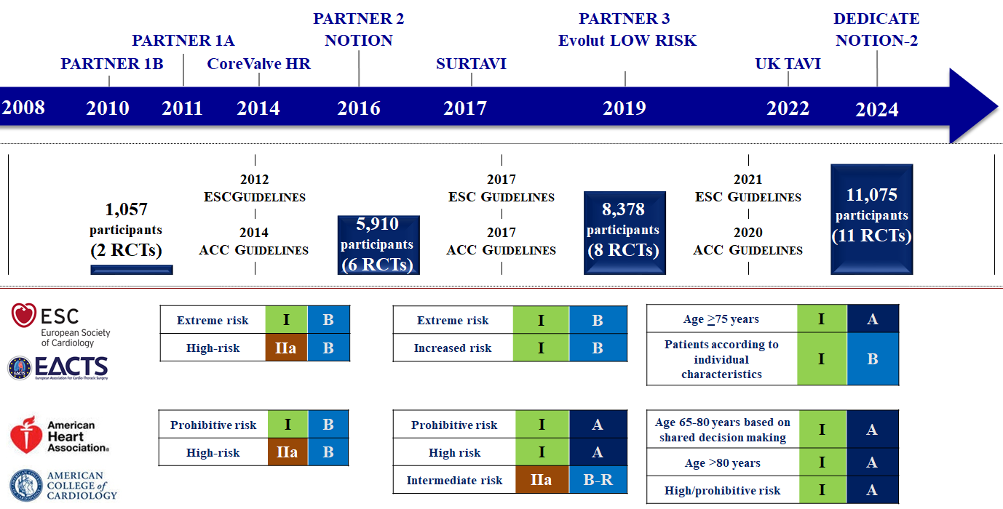

Transcatheter aortic valve implantation
Figure 7
Evolution of transcatheter aortic valve implantation through evidence generation and guidelines.Figures reproduced and modified from Windecker et al. Eur Heart J 2024;45(13):1104-1115.
Daijiro Tomii, Thomas Pilgrim, Jonas Lanz, Taishi Okuno, Stephan Windecker
©2025 Europa Group - All rights reserved.

