Slide 1


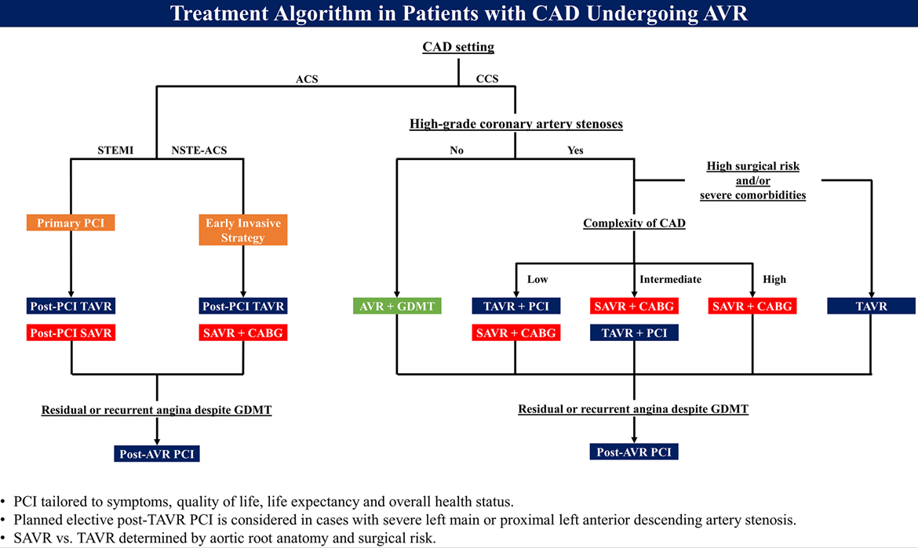

Transcatheter aortic valve implantation
Figure 9
Treatment algorithm in patients with significant coronary artery disease undergoing aortic valve replacement.Figures reproduced from Tomii et al. Circulation 2024;150(25):2046-2069.
Daijiro Tomii, Thomas Pilgrim, Jonas Lanz, Taishi Okuno, Stephan Windecker
©2025 Europa Group - All rights reserved.

