Slide 1


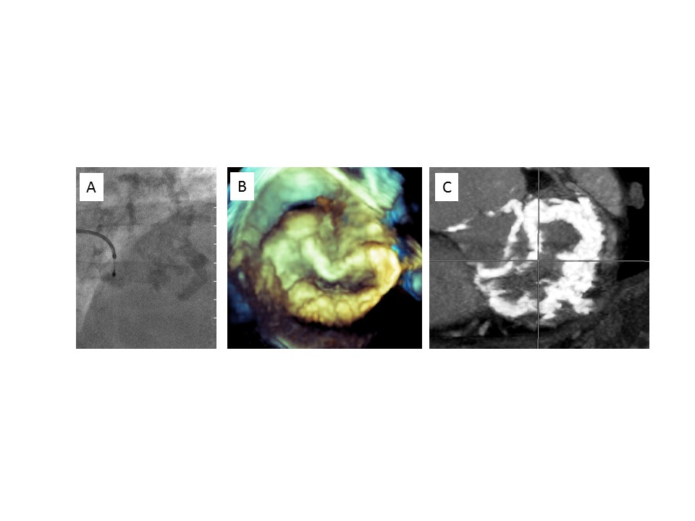

Transcatheter mitral valve implantation (old)
Figure 10
Mitral annulus calcification.A) Fluoroscopy. B) 3D echocardiography. C) CT scan.
Mirjam Wild, Maurizio Taramasso, Alison Duncan, Giulio Russo, Dominique Himbert, Francesco Maisano, Nicolo Piazza, Fabien Praz
©2025 Europa Group - All rights reserved.

