Slide 1


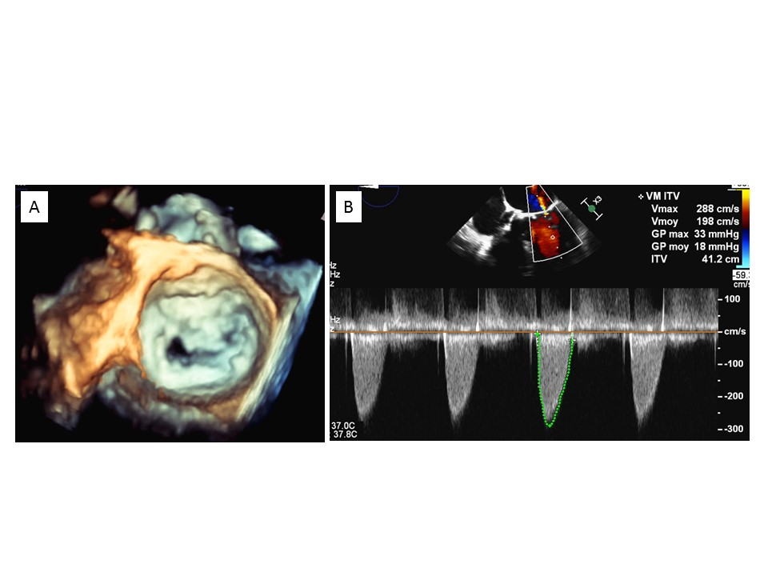

Transcatheter mitral valve implantation (old)
Figure 11
Mitral stenosis related to severe annulus calcification.A) 3D echocardiography. B) Transmitral gradient.
Mirjam Wild, Maurizio Taramasso, Alison Duncan, Giulio Russo, Dominique Himbert, Francesco Maisano, Nicolo Piazza, Fabien Praz
©2025 Europa Group - All rights reserved.

