Slide 1


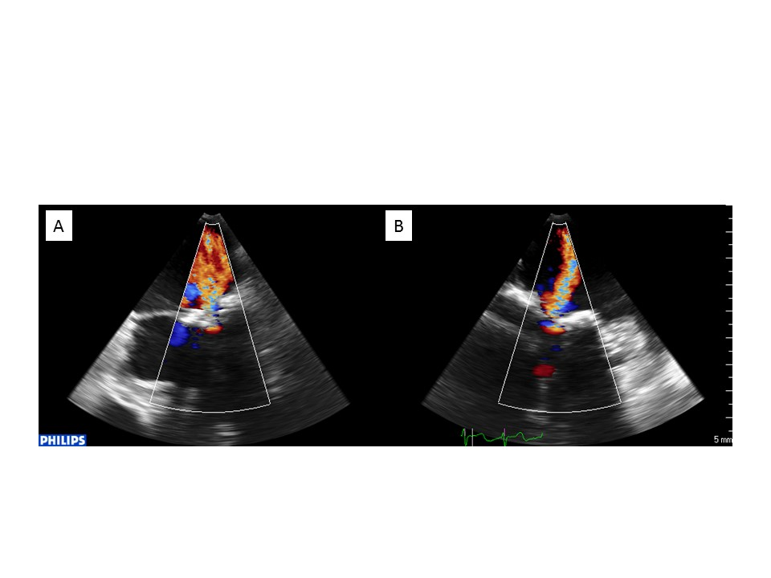

Transcatheter mitral valve implantation (old)
Figure 12
Mitral regurgitation related to severe annulus calcification.Biplane 2D transoesophageal echocardiography showing severe mitral regurgitation related to severe annulus calcification; intercommissural (A) and LVOT (B) views.
Mirjam Wild, Maurizio Taramasso, Alison Duncan, Giulio Russo, Dominique Himbert, Francesco Maisano, Nicolo Piazza, Fabien Praz
©2025 Europa Group - All rights reserved.

