Slide 1


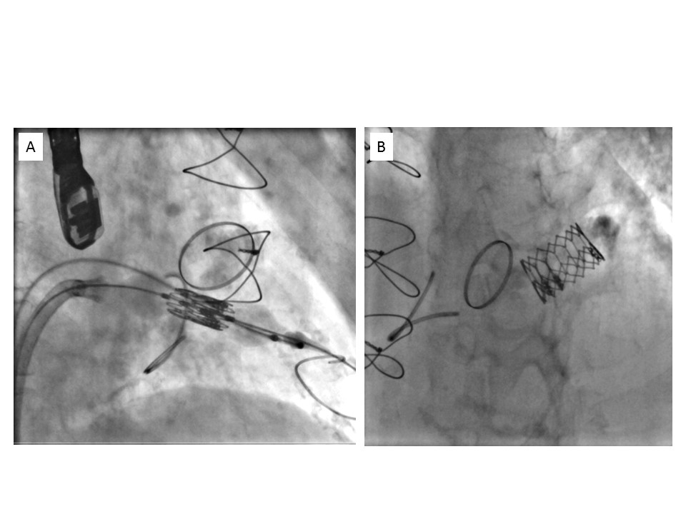

Transcatheter mitral valve implantation (old)
Figure 13
Pure transvenous, transseptal approach for transcatheter mitral valve implantation of a SAPIEN XT valve in mitral annular calcification.A) Beginning of deployment. B) After deployment.
Mirjam Wild, Maurizio Taramasso, Alison Duncan, Giulio Russo, Dominique Himbert, Francesco Maisano, Nicolo Piazza, Fabien Praz
©2025 Europa Group - All rights reserved.

