Slide 1


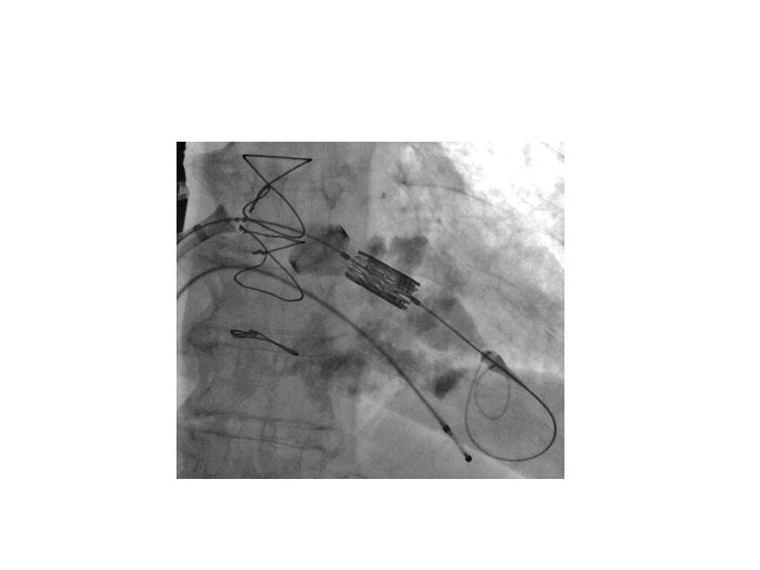

Transcatheter mitral valve implantation (old)
Figure 15
Protrusive mitral annulus calcification extending towards the left atrium and ventricle, with no reliable fluoroscopic landmark of the landing zone.
Mirjam Wild, Maurizio Taramasso, Alison Duncan, Giulio Russo, Dominique Himbert, Francesco Maisano, Nicolo Piazza, Fabien Praz
©2025 Europa Group - All rights reserved.

