Slide 1


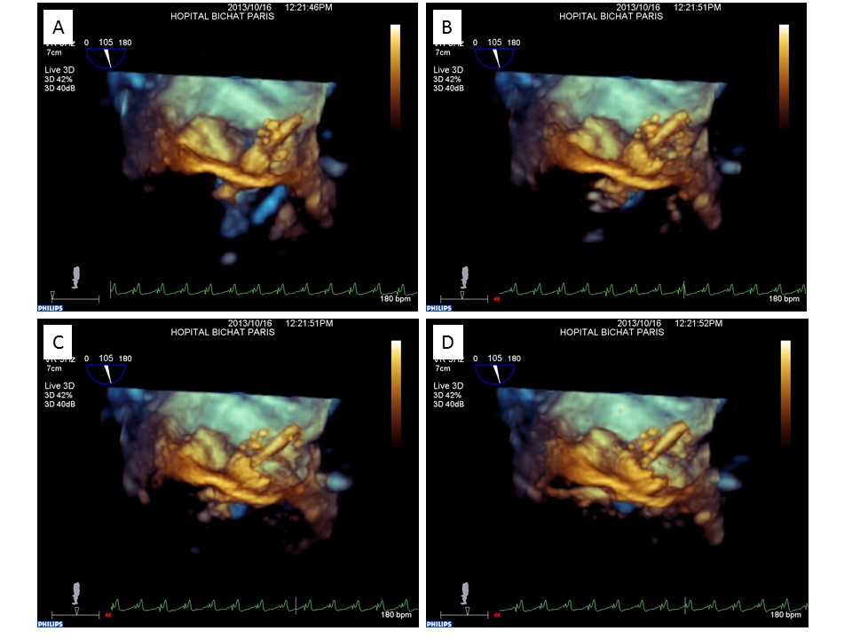

Transcatheter mitral valve implantation (old)
Figure 16
3D transoesophageal echocardiographic guidance of a SAPIEN XT valve implantation in a mitral annulus calcification. A) – D) Different steps of deployment.
Mirjam Wild, Maurizio Taramasso, Alison Duncan, Giulio Russo, Dominique Himbert, Francesco Maisano, Nicolo Piazza, Fabien Praz
©2025 Europa Group - All rights reserved.

