Slide 1


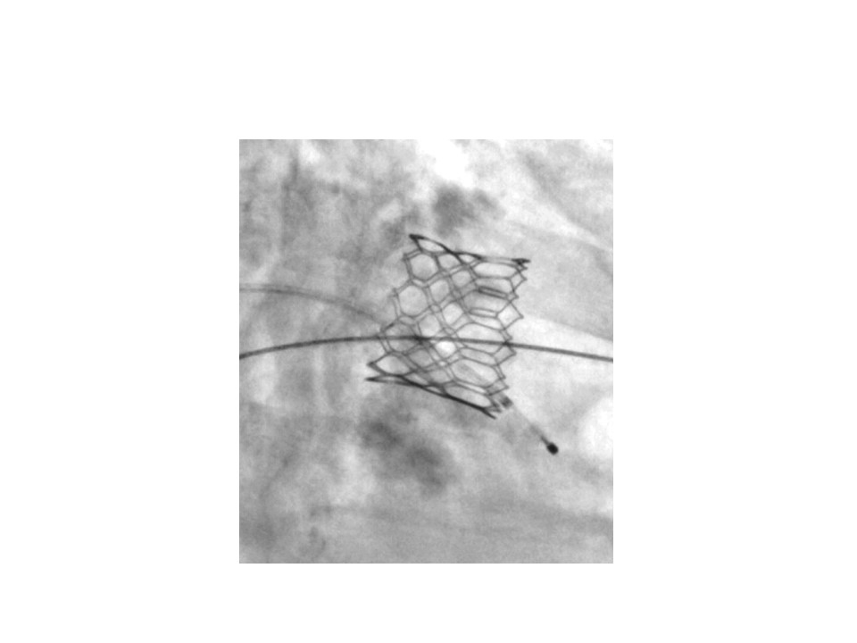

Transcatheter mitral valve implantation (old)
Figure 17
Fluoroscopy after implantation of a SAPIEN XT prosthesis in mitral annular calcification. Flared appearance of the prosthesis to decrease the risk of secondary migration.
Mirjam Wild, Maurizio Taramasso, Alison Duncan, Giulio Russo, Dominique Himbert, Francesco Maisano, Nicolo Piazza, Fabien Praz
©2025 Europa Group - All rights reserved.

