Slide 1


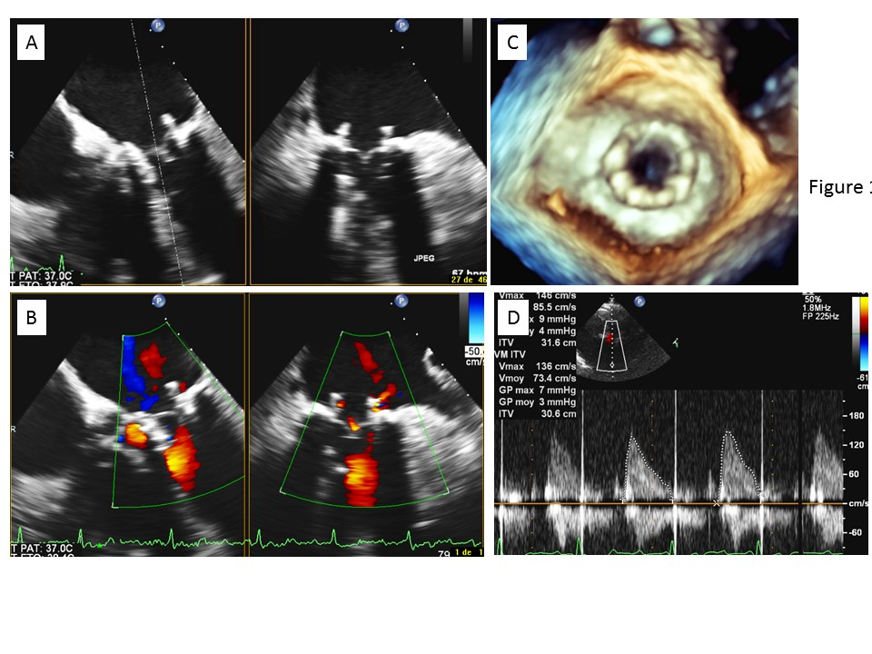

Transcatheter mitral valve implantation (old)
Figure 18
Post-implantation echocardiographic evaluation.A) Biplane 2D transoesophageal echocardiography. B) Colour biplane 2D transoesophageal echocardiography, with no visible mitral regurgitation.C) 3D transoesophageal echocardiography, atrial view. D) Transprosthetic mitral gradient.
Mirjam Wild, Maurizio Taramasso, Alison Duncan, Giulio Russo, Dominique Himbert, Francesco Maisano, Nicolo Piazza, Fabien Praz
©2025 Europa Group - All rights reserved.

