Slide 1


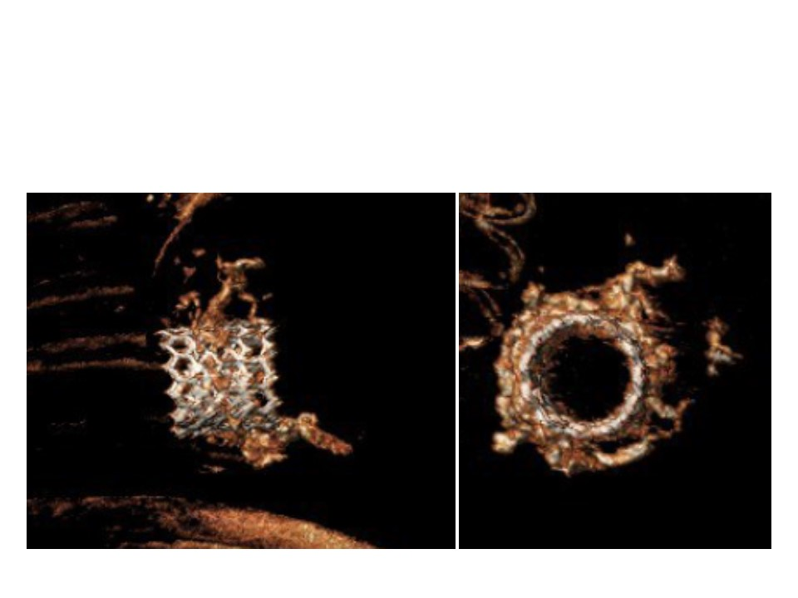

Transcatheter mitral valve implantation (old)
Figure 19
Post-implantation CT scan evaluation.A) Profile. B) En face view.
Mirjam Wild, Maurizio Taramasso, Alison Duncan, Giulio Russo, Dominique Himbert, Francesco Maisano, Nicolo Piazza, Fabien Praz
©2025 Europa Group - All rights reserved.

