Slide 1


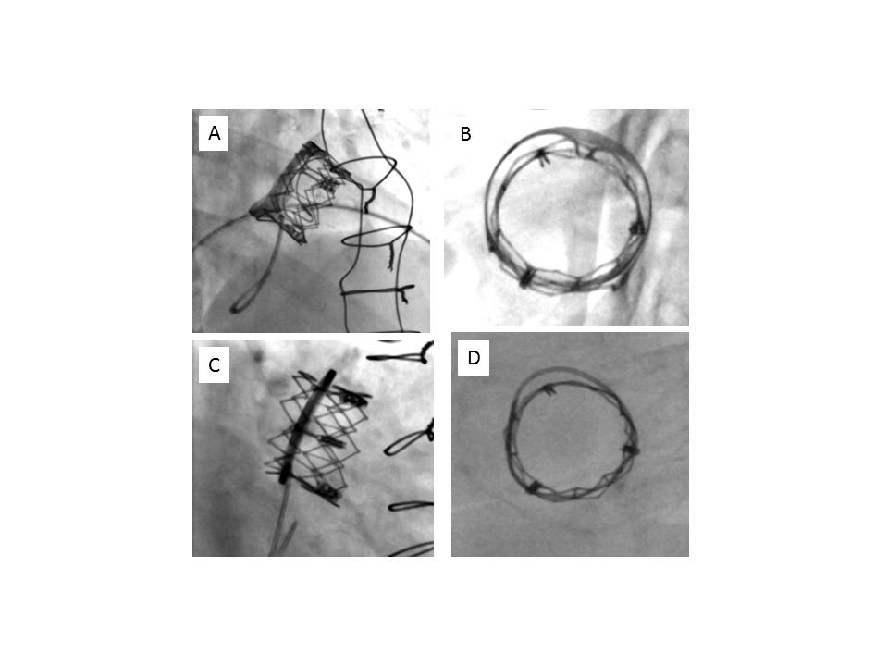

Transcatheter mitral valve implantation (old)
Figure 2
Immediate post-implantation fluoroscopic evaluation. A) Valve-in-valve, profile.B) Valve-in-valve, en face view.C) Valve-in-ring, profile.D) Valve-in-ring, en face view.
Mirjam Wild, Maurizio Taramasso, Alison Duncan, Giulio Russo, Dominique Himbert, Francesco Maisano, Nicolo Piazza, Fabien Praz
©2025 Europa Group - All rights reserved.

