Slide 1


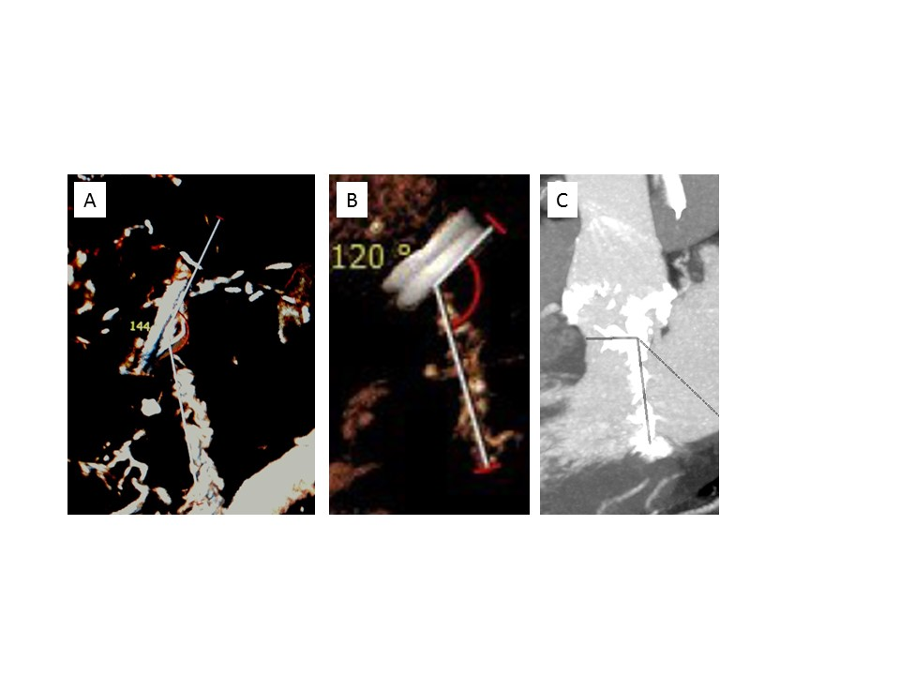

Transcatheter mitral valve implantation (old)
Figure 21
CT scan, determination of the aorto-mitral annular angle before transcatheter valve implantation in mitral annulus calcification. A) Obtuse angle (>140°), minimal risk of left ventricular outflow tract obstruction.B) Acceptable angle (120°).C) Angle close to 90°, high risk of left ventricular outflow tract obstruction.
Mirjam Wild, Maurizio Taramasso, Alison Duncan, Giulio Russo, Dominique Himbert, Francesco Maisano, Nicolo Piazza, Fabien Praz
©2025 Europa Group - All rights reserved.

